Slide 1

Cyanobacteria Blooms;
An Increasing Threat to Our Recreational & Drinking Water!
Stephen J. Souza, Ph.D.
Clean Waters Consulting, LLC
SJSouza.CWC@gmail.com

Slide 2

Thanks To

Slide 3

What the HABs is Going On?

Slide 4
What Is a Harmful Algae Bloom (HAB)?

Slide 5
Harmful Algae Blooms
“Algae bloom” caused by cyanobacteria ...blue-green algae.
Impact lake use, ecology and water quality.
Intense blooms generate very high concentrations of cyanotoxins.
High concentrations of cyanotoxins can impact the health of humans, pets, and livestock.

Slide 6
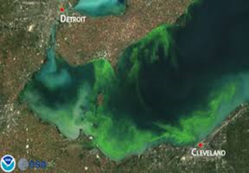

This Is Nothing New!
Cyanobacteria blooms are not a new phenomena, been occurring for millennia.
But public becoming better educated and more aware of the WQ problems and health risks they pose.

Slide 7
What Are Cyanobacteria?
They are prokaryotes…not eukaryotes (such as algae)…lack membrane encased organelles or mitochondria.
However, they can photosynthesize.
Thus share properties of both bacteria and algae.

Slide 8
What Makes Them So Unique?
Many can assimilate atmospheric nitrogen…providing an unlimited source of N.
Biologically adept at assimilating organic phosphorus, better than “good algae”.
Many can regulate positon in water column.
Many do well in low light conditions.
Selectively rejected as food source by filter feeders and zooplankton.
Some produce cyanotoxins.

Slide 9
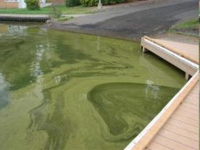
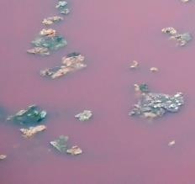
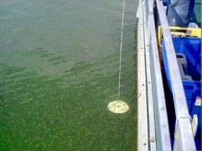

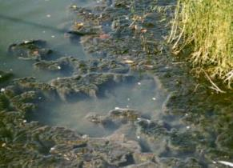
The “Bad Guys”
Microcystis
Planktothrix
Anabaena
Aphanizomenon
Anacapsa
Lyngbya
Gloeotrichia

Slide 10
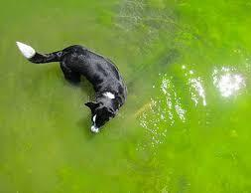
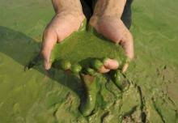
Cyanotoxins
Not produced to directly harm humans, pets and livestock.
Cyanotoxins create a competitive advantage over “good algae”.
May “ooze” out of healthy cyanobacteria.
Large amounts are released when cyanobacteria die.
Relatively stable and slow to biodegrade.

Slide 11
Tell Me More About Cyanotoxins!
Different types of cyanotoxins
  Microcystin-LR
  Cylindrospermopsin
  Anatoxin -a
  Saxitoxins
  Anatoxin-a(S)
These are of greatest interest and concern in freshwater ecosystems

Slide 12
Tell Me More About Cyanotoxins!
Exposure …drinking contaminated water or via contact recreational activities.
Even at low concentrations, recreational contact may cause skin rashes (even for dogs and livestock), ear/throat infections and gastrointestinal distress.
Increased attention being given to possible links between cyanotoxins and neurodegenerative diseases (Parkinson's, ALS, and Alzheimer's).

Slide 13
Why Do HABs Occur?

Slide 14
“Typical” Conditions That
Promote A Bloom
Excessive phosphorus loading.
High water column phosphorus concentrations (could be result of “internal” sources too).
Warm water temperatures.
Plenty of sunlight for photosynthesis.
Water column stability...w/ exceptions.

Slide 15
Not As Simple As It Sounds
“Typical conditions” don’t always lead to bloom.
Not all cyanobacteria cause HABs.
Not all cyanobacteria produce cyanotoxins.
Cyanotoxin producers may not always produce cyanotoxins even during bloom conditions.
Blooms/ high cyanotoxin levels may occur under variable environmental conditions.

Slide 16
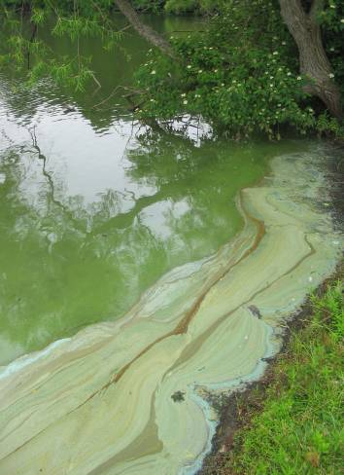
The Common Denominator
Increased phosphorus loading leads to increased productivity and the production of organic carbon.
For lakes, this means more algae...including cyanobacteria.

Slide 17
Phosphorus –
The Primary Driver of Eutrophication
For the lakes, ponds and reservoirs of NJ, phosphorus is typically the “limiting nutrient” or “nutrient of concern”.
Add more phosphorus...get more productivity.
Only need a little phosphorus to stimulate “too much” productivity...0.04 mg/L
1lb phosphorus can create 1,000 lbs of algae!

Slide 18

Eutrophic Lakes Are Not Dead Lakes
Rather They Are Lakes That Needs to Go On a Phosphorus Diet
The bad news...most of NJ’s lakes are eutrophic
and most are susceptible to a HAB

Slide 19
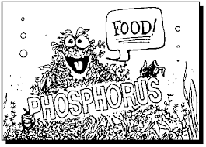

If Phosphorus Is The Problem...Where Is It Coming From?
For The majority (80%) of NJ’s lakes, the root cause of eutrophication is the result of phosphorus loading attributable to stormwater runoff.

Slide 20
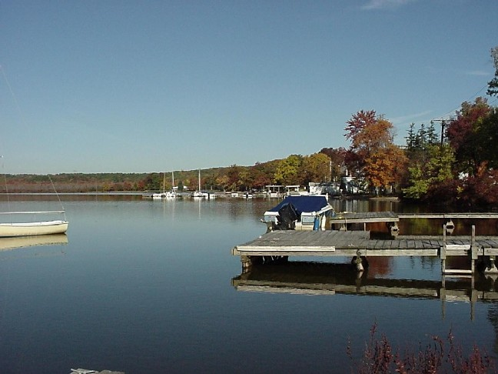
Eutrophic Lake - “A”
Not
Too
Bad

Slide 21
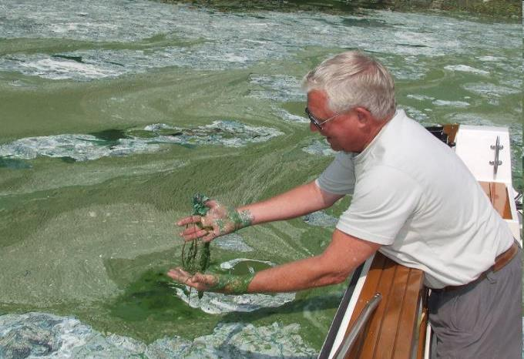
Eutrophic Lake - “B”
Not
Too
Good

Slide 22
Tracking, Controlling and Responding
To a HAB

Slide 23
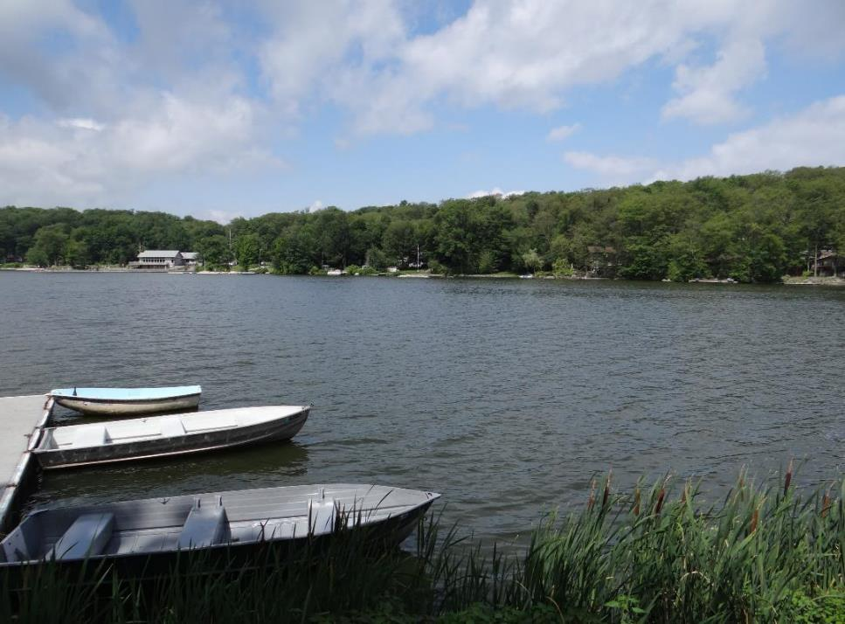
Don’t Just Treat or React to The Symptom….
Identify and Correct the Cause

Slide 24
PARE ^{™ -} A Strategy For
Dealing with HABs
Predict – Forecast a bloom using long-term database, keystone parameters, and/or remote sensing techniques.
Analyze – Measure/quantify bloom’s severity:
  Chlorophyll a,
  Cyanobacteria ID and cell counts
  Measure concentration of Microcystin
React – Implement measures to prevent, control or terminate bloom.
Educate – Share info and keep community informed.

Slide 25
How Do I Know If I Have a Problem
Or Am About to Have a Problem?
Only definitive way is to collect data
  Plankton
  Chlorophyll a
  In-situ (DO, temperature, pH, Secchi)
  Nutrients (Phosphorus and Nitrogen)
  Microcystin / Cylindrospermopsin

Slide 26
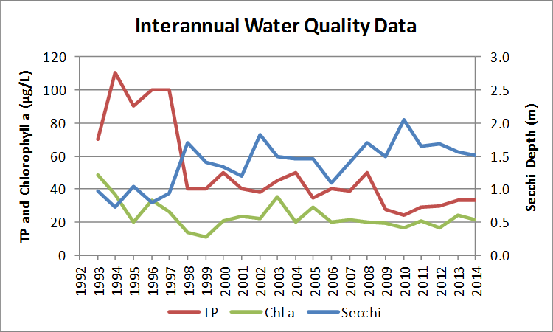
Predict
Develop algorithms using long-term data sets.
  Weather
  Phosphorus and nitrogen
  Chlorophyll
  DO/Temperature profiles
Use resulting “models” to help identify conditions that may trigger HAB.
Implement preventative measures as guided by data.

Slide 27
HAB Indicators
Precursor conditions of impending bloom
  Declining Secchi disc clarity : < 1 meter)
  Chlorophyll a : >20 µg/L)
  Total Phosphorus: > 0.04mg/L
  Algal and Cyanobacteria cell counts: > 20,000 w/ > 50% cyanobacteria
Measure Microcystin (field kits and/or lab testing)
  Drinking Water: >1 μg/L microcystin
  Recreational Lakes: >3 µg/ (advisory); >20 µg/L microcystin (closure)
NJDEP currently relies mostly on
visual evidence (surface scum) and cell counts

Slide 28
Dealing With HABs

Slide 29

You Wouldn’t Build A
House Without A Plan
Can’t Successfully Manage HABs Without a Technically Sound Plan

Slide 30
HAB Management Plan
Identify and quantify what’s causing HAB.
Assess biological, chemical, hydrologic and physical interactions causing HAB.
Identify actions to decrease phosphorus loading...Root Cause Management Action Measures.
Identify actions to prevent, reduce or control manifestation of a HAB...Responsive Management Action Measures.

Slide 31
React –
Prevent, Control & Reduce
Root Cause Management Actions
Prevent - Limit P Loading (Internal and External)...SW Mgmt, Septic Mgmt, Internal Load Control (Nutrient inactivation, Aeration)
Responsive Management Actions
Prevent/Control – Nutrient inactivation, Aeration, Biomanipulation
Reduce – Algaecides, Sonic devices

Slide 32
Watershed Management Strategies
To Limit Phosphorus Loading
Source Controls
    Fertilizer, alternative lawn cover
    Septic management
    Shoreline buffer creation/maintenance
    Waterfowl control
Delivery Controls
    Single lot BMPs
    Large scale, community and regional BMPs

Slide 33
Internal Phosphorus Loading
For some lakes the internally regenerated and recycled phosphorus can be an important driver of productivity and HABs
A major internal source is the phosphorus released from the sediments during periods of anoxia.
Affects both large/small and deep/shallow lakes.
Varies seasonally.
Often overlooked.

Slide 34
Nutrient Inactivation
&
Aeration

Slide 35
Lake Stratification
Lake’s deeper than 6 feet subject to thermal stratification.
Results in formation of distinct thermal/density layers.
Density differences impede vertical mixing of water column, effectively segregates top from bottom.
Leads to oxygen depletion, internal recycling of nutrients and metals, and impacts to water quality.
Most NJ lakes stratify to some extent.
Most are dimictic or polymictic, mix more than once annually.

Slide 36
Seasonal Progression of Stratification
Spring
Summer
Autumn

Slide 37
Stratification - Destratification
Dimictic – Most common condition for large deep (>15’) lakes in NJ, water column turns over in spring and fall (fall turn over greatest).
Monomictic – Turns over once per year, mostly southern lakes, driven by rainfall.
Polymictic – Stratifies / Destratifies a number of times per year.
Non-stratified – Too shallow or quickly flushed to thermally stratify.
Most NJ lakes, ponds and reservoirs are dimictic or polymictic

Slide 38
Temperature, DO, Nutrients & Minerals
Oxic
Algae
Thermocline
Anoxic
Phosphorus, Fe, SO₄, Mg, Released
Sediment Bound Phosphorus,
Metals and Minerals

Slide 39
Destratification Aeration
Most commonly implemented aeration strategy for HAB management
Maintain lake in a thermally uniform, well oxygenated state.
Use compressed air to maintain vertical upwelling of water...prevents thermal stratification and reduces internal P loading.

Slide 40
Submerged or Destratification Aeration
Land based compressor
Basic Submerged Aerator Setup
Weighted Air Line
Diffusers

Slide 41
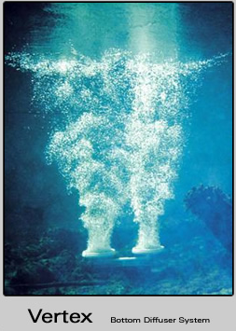
Destratification Aeration System
Fine pore air flow
Compressed air diffuser
Weighted airline

Slide 42
How Does Aeration Help?
Properly designed, sized and operated aeration system can...
Prevent or limit thermal stratification.
Prevent or control anoxia.
Reduce internal recycling of phosphorus.
Decrease accumulation of dense surface. scums.
Drive cyanobacteria cells into deeper water.

Slide 43
Nutrient Inactivation
Nutrient inactivators bind with phosphorus making it unavailable for algal or cyanobacteria assimilation
This limits growth rates and contributes toward a reduction in the magnitude and frequency of blooms
Less “food” = less algae and less cyanobacteria

Slide 44
Phosphorus Inactivation
Alum (aluminum sulfate, sodium aluminate)
Polyaluminum chloride (PACl)
Iron
PhosLock (Lanthunum)
Calcium
Certain polymers

Slide 45
Alum
When applied in water forms colloidal aggregates of aluminum hydroxide.
Phosphates (PO₄) bond with aluminum hydroxide.
Also used to strip or clarify water column.
Applied in large amounts to create “alum blanket” ...binds phosphorus released from sediment under both oxic and anoxic conditions.

Slide 46
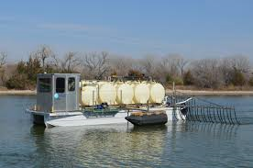
Alum storage tanks
Trailing arms
Stabilization
out-rigger

Slide 47
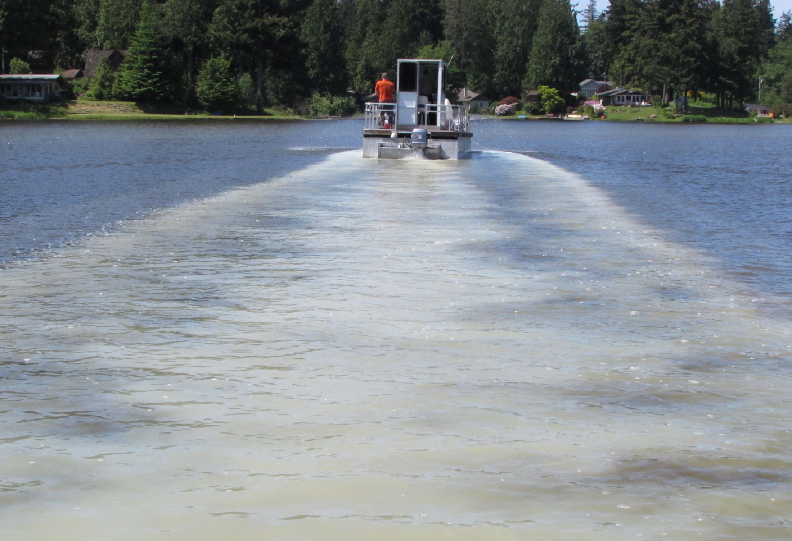

Slide 48
Continuous Metered Dosing
Alum delivered daily at a specified dose.
Dose rate basically equals daily modeled internal and/or external TP load.
Dose rate may vary seasonally.
Aeration system used to mix the alum into the water column and promote phosphorus binding.

Slide 49
In-Lake Metered Dosing
Pump House w/ Storage Tanks, Air Compressor, Metering Pumps and Electrical Board
Diffuser & Aerator
Alum
Injectors

Slide 50
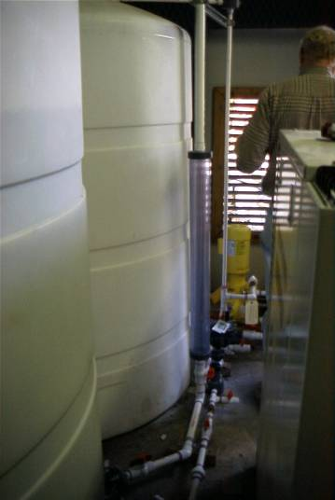
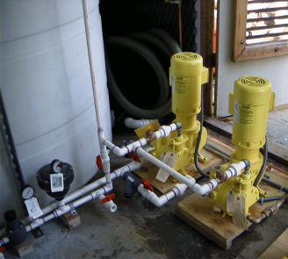
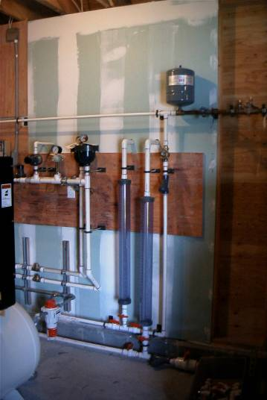
Alum introduced daily in small, pre-computed dosages to bind phosphates in water column

Slide 51
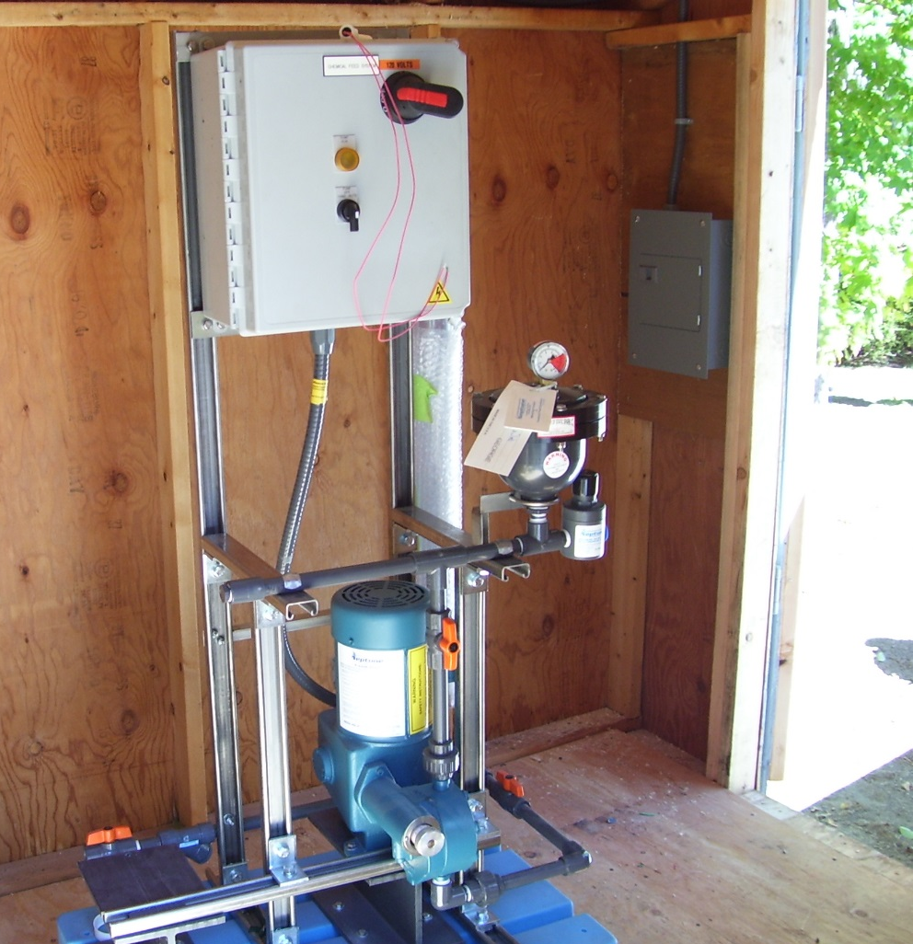
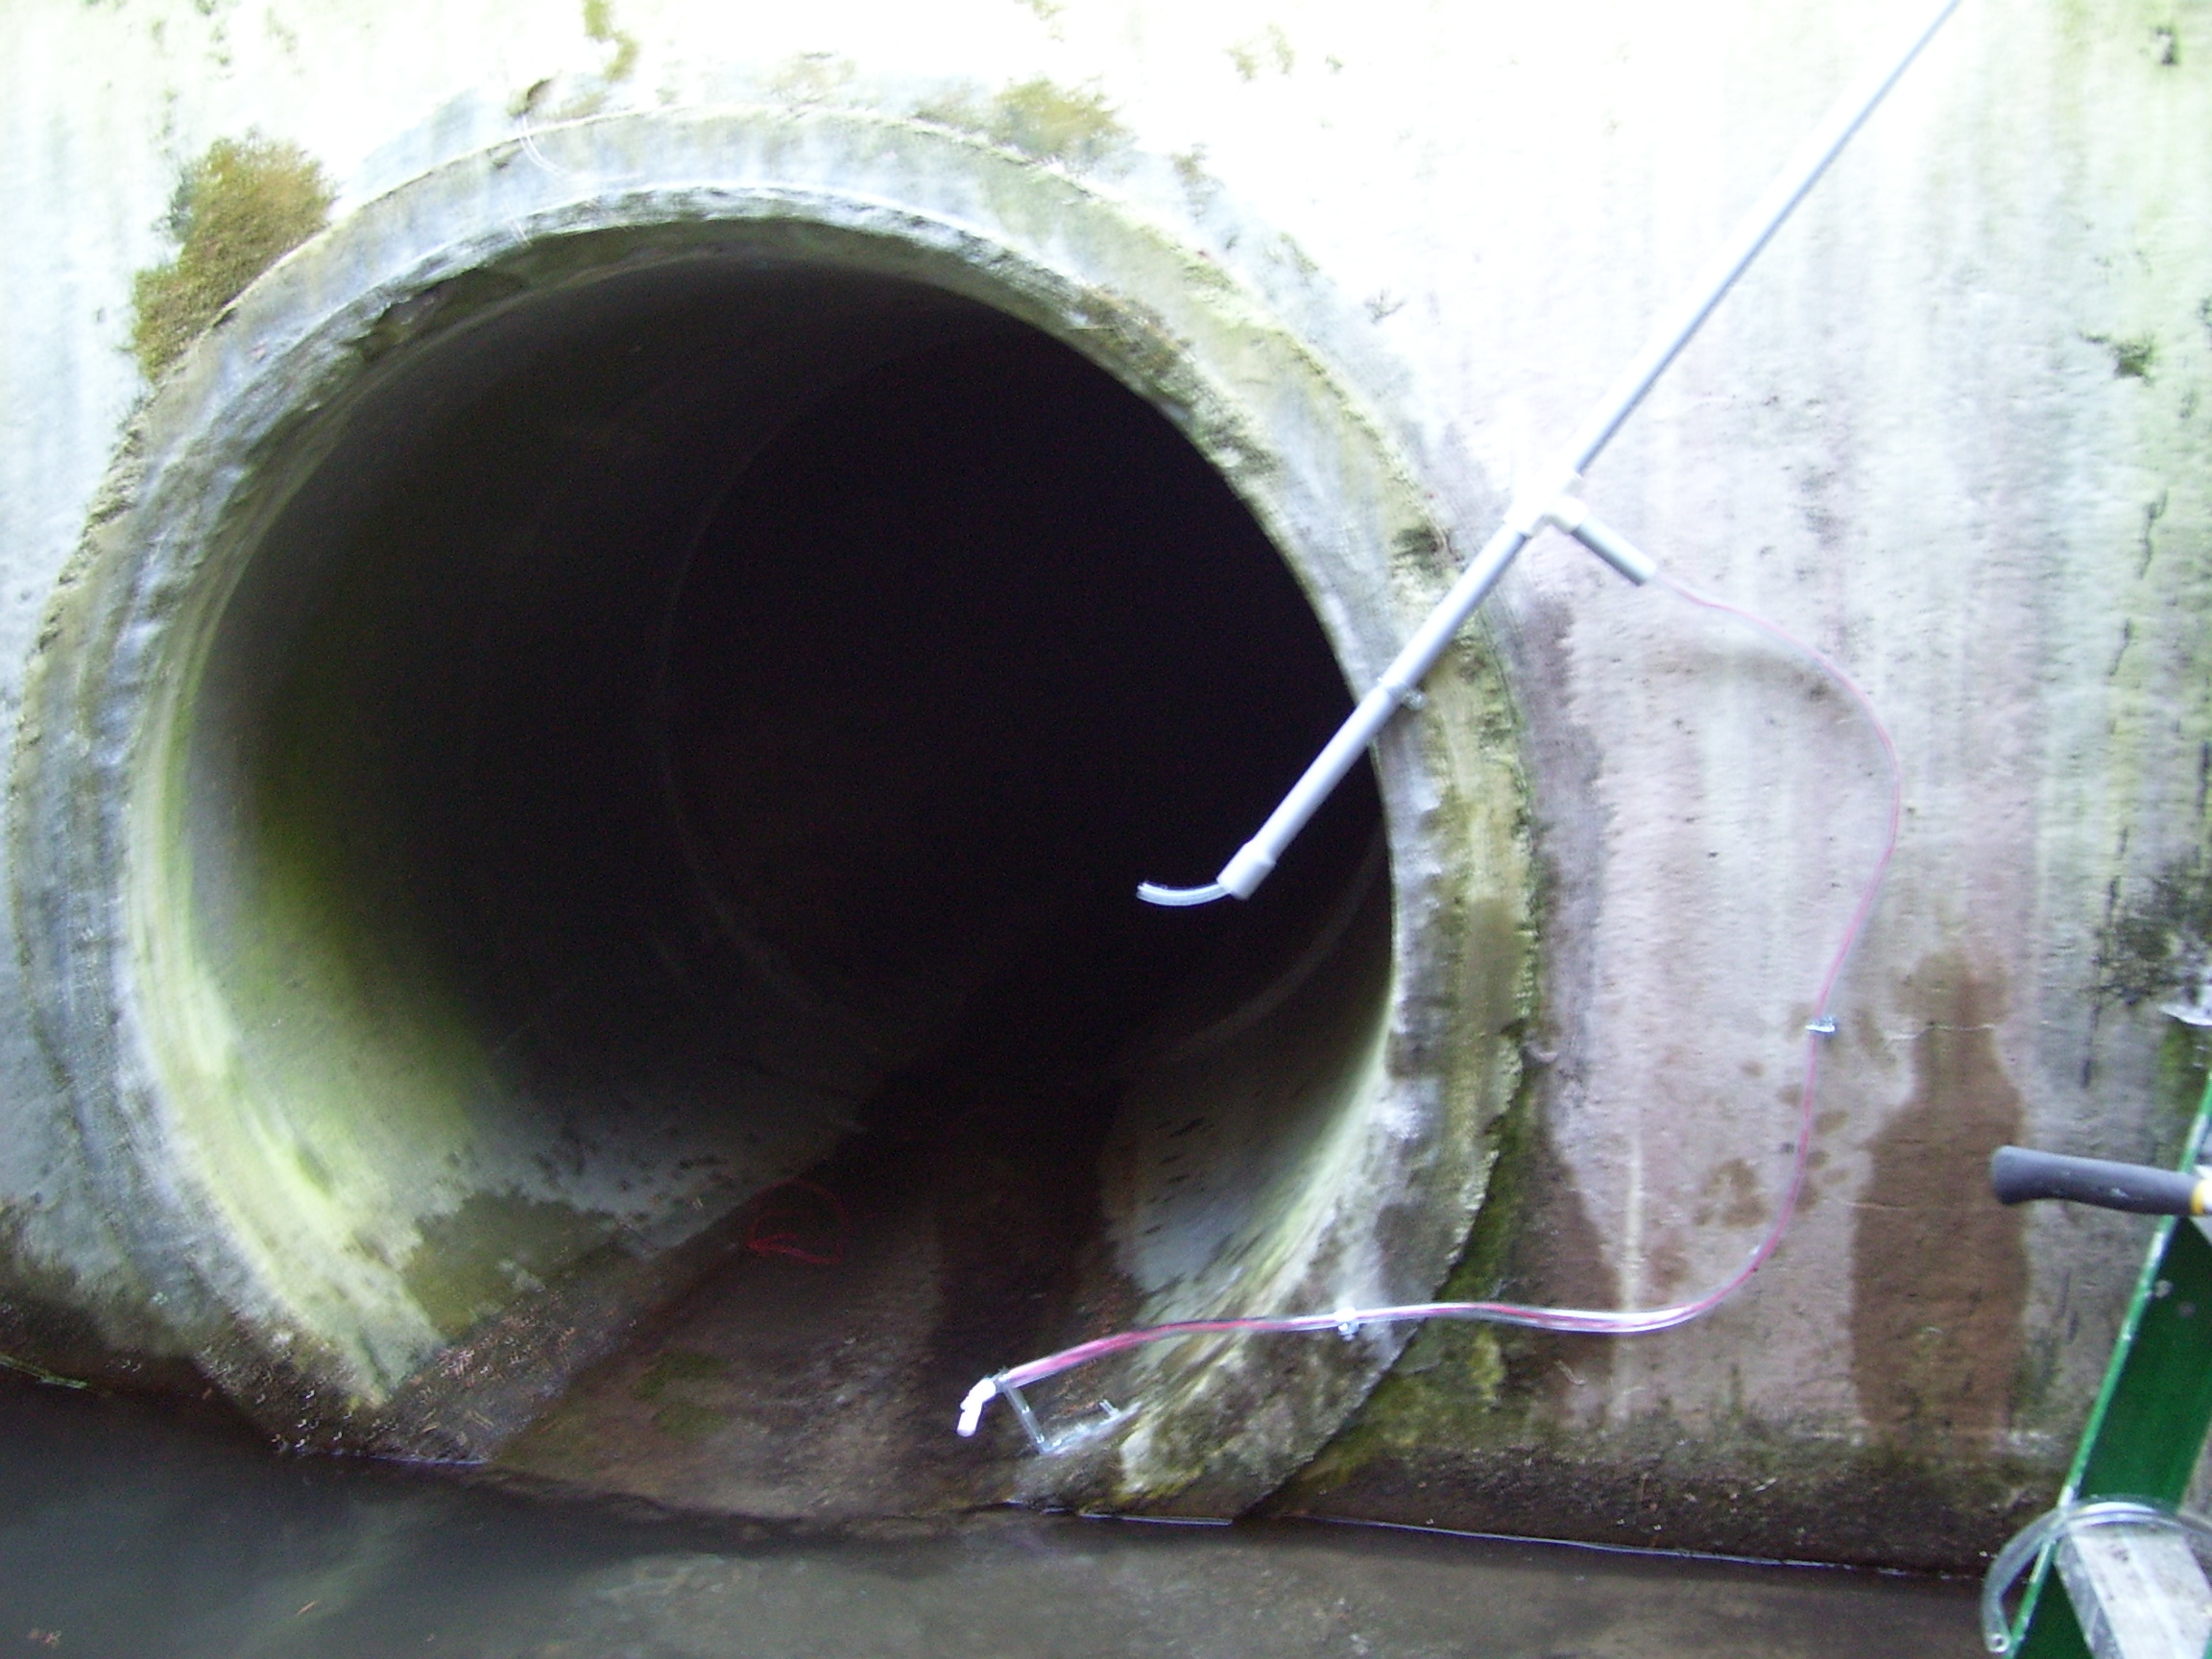
Stormsewer dosing system...injects given amount of alum over a specified time during a storm event. Reduces phosphorus conveyed into lake with runoff

Slide 52
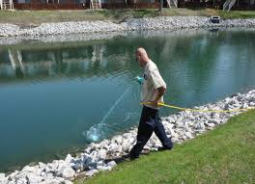
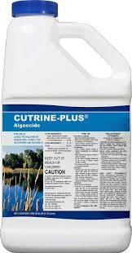
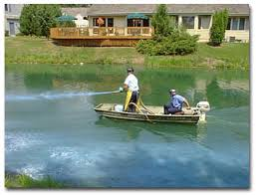
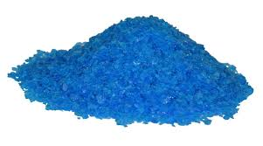
Why Not Just Bomb
Bloom With Copper Sulfate?

Slide 53
The Paradox of
Copper Sulfate Treatments
Copper based algaecide treatments can be part of a HAB management strategy.
But should not be the “go to” solution.
Reliance on CuSO4 only creates an environment that much more conducive for more cyanobacteria growth...blooms returns often that much more intense.

Slide 54
The Paradox of
Copper Sulfate Treatments
May temporarily relieve bloom conditions but can actually exacerbate problem.
Largescale algaecide treatments lead to the rapid release of large amounts of cyanotoxins and organic phosphorus.
Treatments also kill off “good algae” and zooplankton, rapid die off can depress oxygen levels leading to a fish kill.

Slide 55
In Summary

Slide 56
In Summary….HABs
HABs are not a new thing.
Frequency and severity of HABs is increasing.
At very high densities, cyanobacteria negatively affect health of humans, pets and livestock.
NJ’s lakes are phosphorus rich and therefore susceptible to HABs...Key to preventing HABs is phosphorus management.
Copper sulfate is not the primary solution and can actually worsen conditions and intensify HABs and their impacts.

Slide 57



Our Goal

Slide 58
For More Information on HABs
NJDEP -
https://www.state.nj.us/dep/wms/HABS.html
https://www.state.nj.us/dep/wms/bfbm/download/NJHABResponseStrategy.pdf
NALMS.org
https://www.nalms.org/home/nalms-inland-hab-program/
NYSDEC –
https://www.dec.ny.gov/chemical/77118.html
https://www.dec.ny.gov/docs/water_pdf/habsbrochure.pdf

Slide 59
For More Information on HABs
EPA and Others...
https://www.epa.gov/nutrientpollution/harmful-algal-blooms
http://oceanservice.noaa.gov/hazards/hab/
http://www.cdc.gov/nceh/hsb/hab/
http://www2.epa.gov/nutrientpollution/harmful-algal-blooms
https://www.health.state.mn.us/diseases/hab/hab.pdf

Slide 60
Stephen J. Souza, Ph.D.
Clean Waters Consulting, LLC
SJSouza.CWC@gmail.com
Thank You….

